Slide 1
IMAGE DEBLURRING USING DEEP-BASED PROCESS

Slide 2
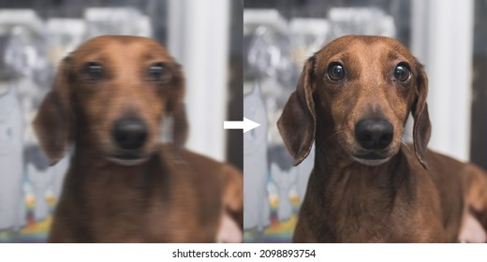
INTRODUCTION
Deblurring is the process of removing blurring artifacts from images. Deblurring recovers a sharp
Image from a blurred image
Image deblurring using deep learning-based processes has gained significant attention in recent
years. Deep learning models have shown promising results in effectively restoring blurred images
by learning the underlying mapping between the blurred and sharp image pairs.

Slide 3
GENERAL PROCESS FOR IMAGE DEBLURRING USING DEEP LEARNING:
Data collection
Preprocessing
Network architecture selection
Model training
Loss function
Optimization
Validation
Inference

Slide 4
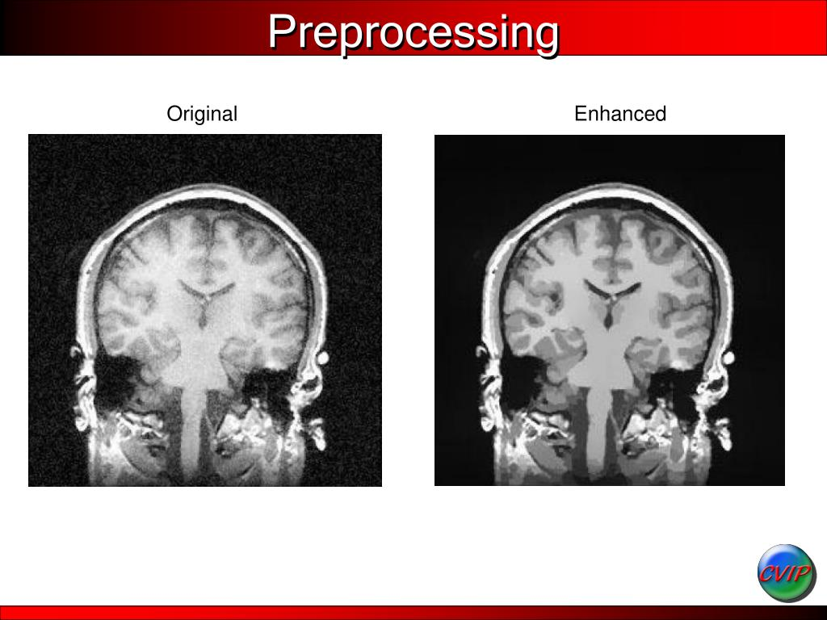
Data Collection:
Collect a dataset of paired images consisting of blurred images and their corresponding sharp,
high-resolution versions. You can either acquire or create this dataset.
Preprocessing:
Preprocess the dataset by resizing the images, normalizing pixel values, and augmenting the data
if required. Common data augmentation techniques include rotation, scaling, and flipping.

Slide 5
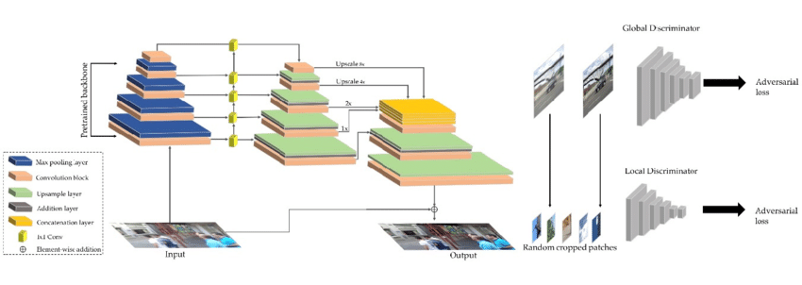
Network architecture selection:
Choose a suitable deep learning architecture for image deblurring. Convolutional neural networks
(CNNs) are commonly used for this task. Some popular architectures include U-Net, ResNet, and
Generative Adversarial Networks (GANs).
Model training:
Train the selected deep learning model using the prepared dataset. The goal is to learn the
mapping between the blurred and sharp image pairs, enabling the model to predict sharp images
when given a blurry input.

Slide 6
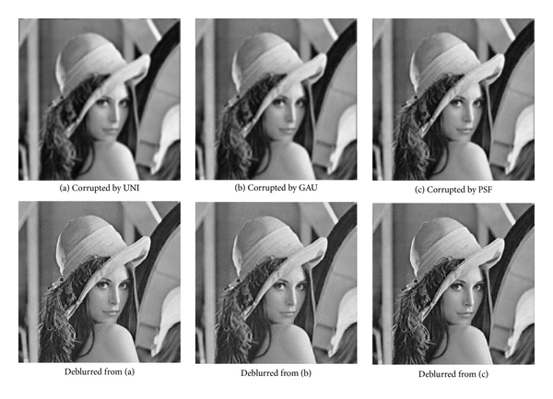
Loss function:
Define an appropriate loss function to measure the difference between the predicted sharp image
and the ground truth sharp image. Common loss functions for image deblurring include Mean
Squared Error (MSE), Structural Similarity Index (SSIM), or perceptual loss based on pre-trained
networks such as VGG or AlexNet.
Optimization:
Optimize the model using gradient descent or its variants to minimize the loss function.
Techniques such as stochastic gradient descent (SGD) or Adam optimizer are commonly used.

Slide 7
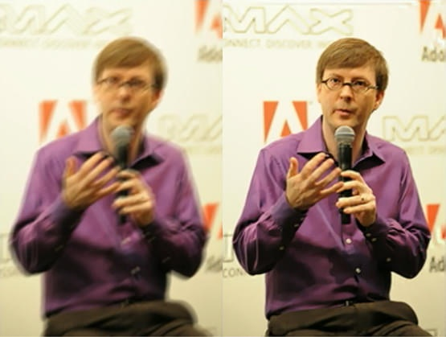
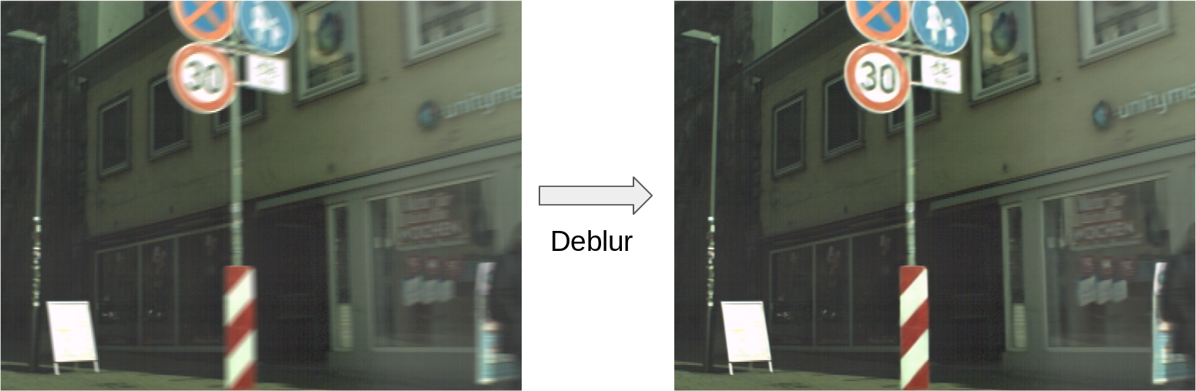
Validation:
Evaluate the trained model using a separate validation dataset to assess its performance and
fine-tune the hyperparameters if necessary.
Inference:
Once the model is trained and validated, it can be used to deblur new images. Pass a blurry image
through the trained model, and it will generate a deblurred version of the input image

Slide 8
CONCLUSION:
It's important to note that deep learning-based image deblurring is an active research area,
and different variations and improvements to the above process are continuously explored.
The effectiveness of the deblurring process depends on factors such as the quality and
diversity of the training dataset, the chosen architecture, and the optimization strategy employed.

Slide 9
Thank-You
ARJUN J
2GI20EC027

